Slide 1
Student Database Management system
Team Members :
Dharanesh P – CB.EN.U4CCE23009
Jayanth C R – CB.EN.U4CCE23018
K B Vishal – CB.EN.U4CCE23019

Slide 2

abstract
The Student Database Management System (SDMS) is a web-based application developed to streamline and automate student data management in educational institutions. The system efficiently handles student records, academic performance, staff records, hostel/day scholar details, fees, and extracurricular information.
The project uses MySQL for secure data storage, PHP for backend processing, and HTML and CSS for creating an interactive and user-friendly frontend. Integrated through XAMPP, the system allows seamless communication between the frontend and the database.
The SDMS enhances data accuracy, reduces manual workload, and improves administrative efficiency. It showcases the practical application of web development and database technologies to solve real-world institutional challenges.
Key Features:
Student Management
Department & Course Handling
Staff & Instructor Records
Hostel Management
Payments Module
Grades
Sports Participation
User Roles & Authentication
Pass Requests
Relational Database Design

Slide 3
Introduction
Educational institutions often face challenges with manual student data management, leading to errors, duplication, and inefficiencies in handling records like academics, hostel allocations, and fee payments.
The Student Database Management System is developed to automate and streamline the management of student information, including personal details, academic performance, hostel/day scholar status, transport usage, and extracurricular activities.
By centralizing data in one system, it ensures faster processing, reduces administrative workload, improves data accuracy, and facilitates smooth access to information for students and staff.

Slide 4
OBJECTIVES
To automate student data management and reduce manual errors.
To centralize all student records in a single, integrated system.
To efficiently manage academics, hostel/day scholar details, and transportation data.
To streamline fee and payment tracking for tuition, hostel, mess, and transport.
To improve accessibility and real-time availability of student information for authorized users.
To ensure data security, integrity, and consistency across all modules.

Slide 5
Proposed System
The proposed Student Database Management System is a web-based platform designed to overcome the limitations of traditional manual record-keeping in educational institutions. It centralizes student-related operations, enabling efficient interaction between students, administrative staff, instructors, hostel wardens, and department heads.
The system maintains a comprehensive database for student profiles, academic records, hostel allocations, transport details, fee payments, sports participation, and pass requests. It supports real-time data management, automated fee tracking, and streamlined hostel and course allocations.
Role-based access ensures secure handling of sensitive information, while integrated modules enhance operational efficiency. By reducing paperwork and improving data accuracy, the system supports faster decision-making, improves institutional workflows, and enhances the student experience.

Slide 6
Methodology

Slide 7

1. Requirement Analysis
Identified key problems in manual student data management.
Collected functional and non-functional requirements from stakeholders.
Defined system objectives and scope based on institutional needs.

Slide 8

2. System design
Created Entity-Relationship (ER) diagrams and data flow diagrams (DFDs).
Designed the database schema for managing students, staff, hostels, courses, payments, and other modules.
Structured the front-end layout with user-friendly navigation for different user roles.

Slide 9

3. development
Designed and developed the database using MySQL, defining entities such as students, courses, departments, hostels, payments, and more.
Built the frontend using HTML AND CSS to create user-friendly forms, dashboards, and interfaces for different users (Admin, Students, Staff, etc.).
Implemented backend logic with PHP to handle data operations (insert, update, delete, view) and manage the connection between frontend and database.

Slide 10

4.Intregrating and testing
Integrated the frontend, backend, and database modules on a local server using XAMPP.
Conducted unit testing, integration testing, and user acceptance testing to ensure system functionality, data accuracy, and secure role-based access.

Slide 11

5.Deployment and documentation
Deployed the system on a local environment for demonstration.
Prepared necessary technical documentation, including user guides and system manuals, to support future use and maintenance.
Ensure secure access and backup mechanisms.

Slide 12
Database design

Slide 13
TABLES AND ATTRIBUTES
Department: department_id, department_name.
Department_Heads: department_head_id, name, email, department_id, salary_id.
Courses: course_id, course_name, department_id, total_credits.
Instructors: instructor_id, name, gender, contact_number, email, department_id, course_id, joining_date, salary_id.
Boys_Hostel: hostel_id, hostel_name, capacity, available_capacity.
Girls_Hostel: hostel_id, hostel_name, capacity, available_capacity.
Hostel_Wardens: warden_id, name, gender, contact_number, email, boys_hostel_id, girls_hostel_id, is_head_warden, salary_id.
Students: student_id, name, gender, dob, contact_number, email, hostler_or_day, avails_bus, department_id, boys_hostel_id, girls_hostel_id.
Office_Staff: staff_id, name, position, contact_number, email, salary_id.
Salary: salary_id, salary_amount.
Users: user_id, password, role, student_id, staff_id, warden_id, department_head_id, instructor_id.
Sports: student_id, sport_name, team_position.
Grades: grade_id, student_id, course_id, total_course_credits, grade.
Pass_Requests: pass_id, student_id, pass_type, start_date, end_date, approval_status.
Hostel_Payments: payment_id, student_id, hostel_fee_paid, mess_fee_paid, payment_date, payment_due_date.
Education_Payments: payment_id, student_id, tuition_fee_paid, payment_date, payment_due_date, payment_type.
Day_Scholar_Payments: payment_id, student_id, bus_fee_paid, payment_date, payment_due_date, payment_type.
Hostel_Allocations: allocation_id, student_id, boys_hostel_id, girls_hostel_id, room_number, allocation_date.

Slide 14
RELATIONSHIP BETWEEN TABLES
The system is built on a relational database structure where multiple entities are interconnected to ensure data consistency and integrity.
The Department table connects with Courses, Instructors, Students, and Department_Heads via department_id. Each department has multiple courses, instructors, and students, while each department is headed by one Department_Head.
The Courses table is linked to Instructors and Grades through course_id, associating courses with instructors and student performance.
The Students table is central, connecting to Departments, Hostels, Sports, Grades, Pass_Requests, Payments (Hostel, Education, Day Scholar), and Hostel_Allocations using student_id. It tracks student academics, accommodation, and financial records.
Hostel_Wardens relate to both Boys_Hostel and Girls_Hostel via hostel IDs, assigning wardens to respective hostels.
The Users table links login credentials to roles like Student, Instructor, Warden, Office Staff, and Department Head, ensuring role-based access.
Lastly, salary information is connected to Instructors, Wardens, Department Heads, and Office Staff via the Salary table.

Slide 15
System design

Slide 16
SYSTEM DESIGN
The system design of the Student Database Management System focuses on creating a structured and modular architecture to efficiently handle academic, administrative, and hostel-related data.
At the core is a centralized MySQL database, which organizes all entities like Students, Departments, Courses, Hostel information, Staff, and Payments into well-defined relational tables. The system follows an entity-relationship (ER) model, establishing clear connections between tables to ensure data consistency and reduce redundancy.
The front-end is built using HTML and CSS to provide a user-friendly interface for students, staff, and administrators. It interacts with the back-end through PHP, which handles the server-side logic and connects the front-end to the database using XAMPP.
The design ensures role-based access where users log in as Students, Instructors, Department Heads, Hostel Wardens, or Office Staff, each accessing relevant modules and data. The system also integrates validation, reporting, and secure data handling mechanisms to support efficient student management operations.

Slide 17
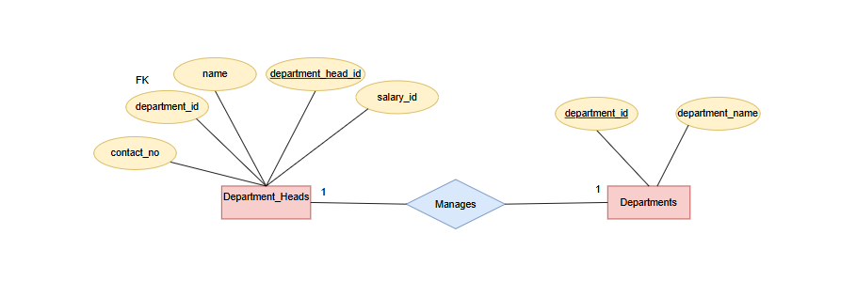
Department and Department Head Tables
Each department is managed by a department head who oversees its academic and administrative activities. The department head ensures smooth functioning and coordination within the department. Technically, this is implemented through a one-to-one relationship where department_id in the Department_Heads table references department_id in the Department table as a foreign key.

Slide 18
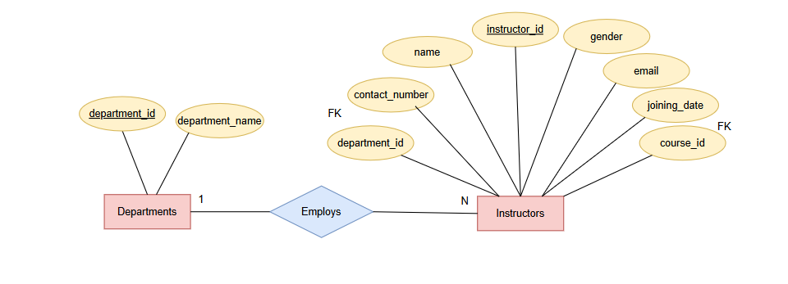
Departments and Instructors Tables
Each department assigns instructors to handle various courses and academic responsibilities under its domain. Instructors contribute to teaching and departmental activities. Technically, this is a one-to-many relationship where multiple instructors are linked to a single department using department_id as a foreign key in the Instructors table referencing the Department table.

Slide 19
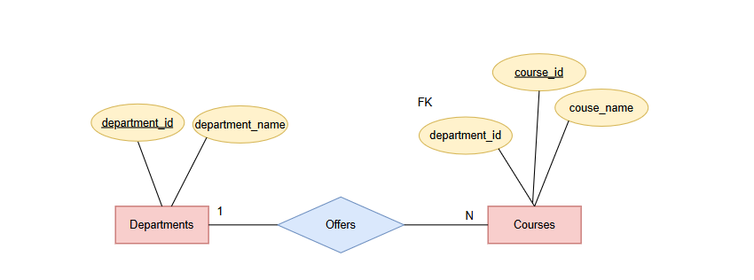
Department and Courses Tables
Each department offers multiple courses as part of its academic curriculum to cater to various subjects and specializations. The department is responsible for managing and updating these courses. Technically, this forms a one-to-many relationship where department_id in the Courses table acts as a foreign key referencing the Department table.

Slide 20
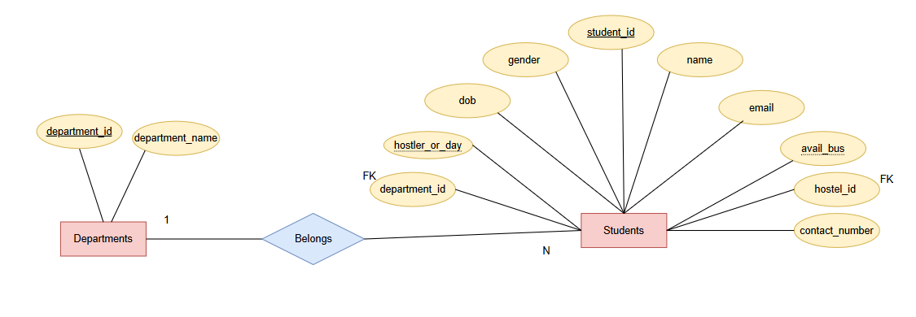
Department and Student Tables
Each department enrolls multiple students who pursue courses and participate in departmental activities. The department manages the academic progress and records of its students. Technically, this is a one-to-many relationship where department_id in the Students table acts as a foreign key referencing the Department table.

Slide 21
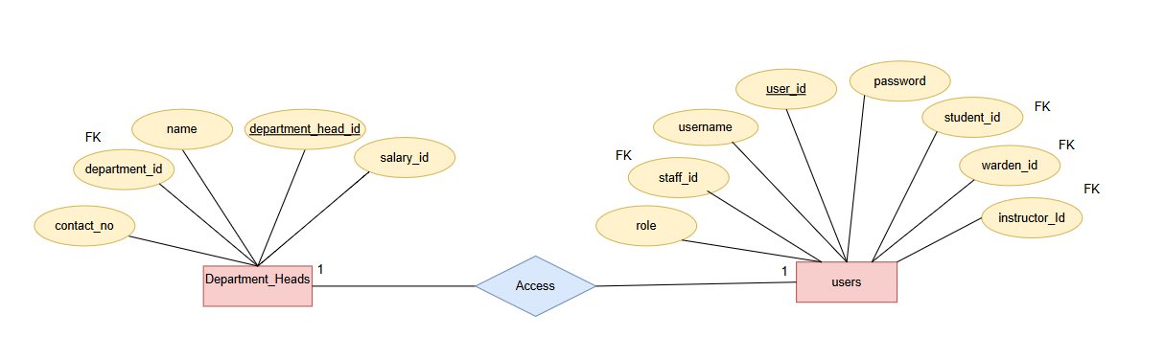
Users and Department Head Tables
Each department head is assigned a user account to securely access the system and perform their administrative duties. This ensures role-based access control for department heads. Technically, this is a one-to-one relationship where department_head_id in the Users table acts as a foreign key referencing the Department_Heads table.

Slide 22
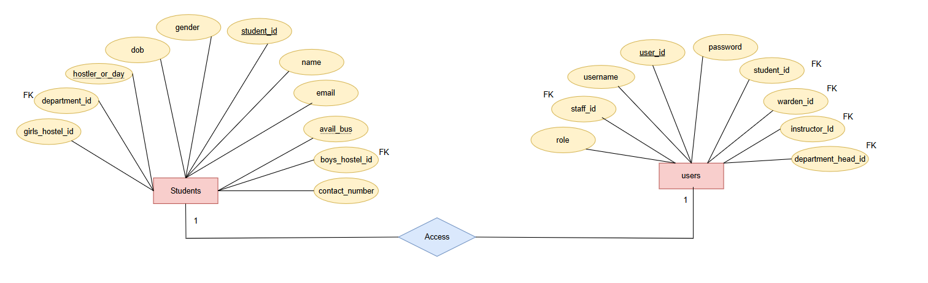
User and Student Tables
Each student is assigned a user account to access the system, view academic records, and manage personal details. This ensures secure and role-based access for students. Technically, this is a one-to-one relationship where student_id in the Users table acts as a foreign key referencing the Students table.

Slide 23
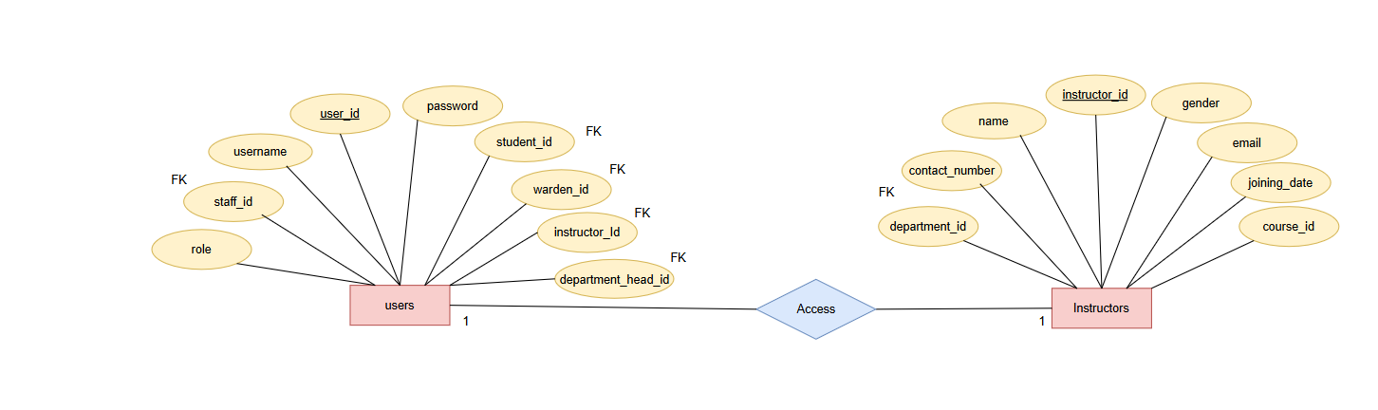
Users and Instructors Table
Each instructor is assigned a user account to access the system, manage courses, and update student records. This ensures secure and role-based access for instructors. Technically, this is a one-to-one relationship where instructor_id in the Users table acts as a foreign key referencing the Instructors table.

Slide 24
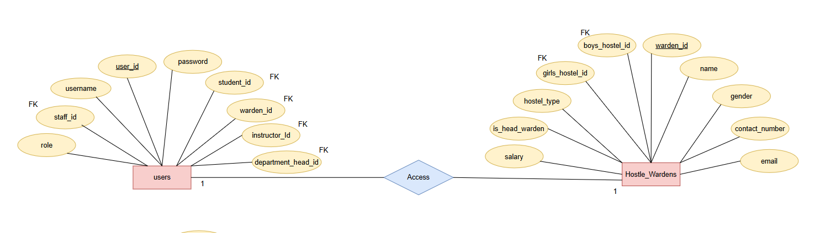
Users and Hostel Wardens Table
Each hostel warden is assigned a user account to manage hostel activities, student accommodations, and administrative tasks. This ensures secure and role-based access for wardens. Technically, this is a one-to-one relationship where warden_id in the Users table acts as a foreign key referencing the Hostel_Wardens table.

Slide 25
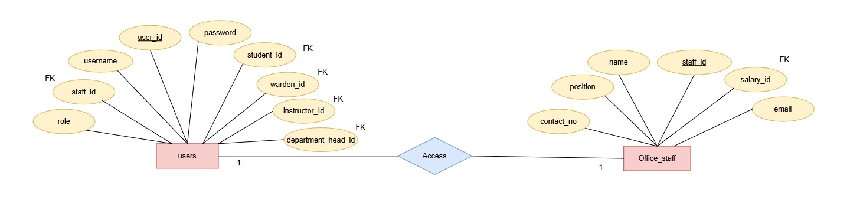
Users and Office Staff Table .
Each office staff member is assigned a user account to manage administrative tasks, student records, and payments. This ensures secure and role-based access for office staff. Technically, this is a one-to-one relationship where staff_id in the Users table acts as a foreign key referencing the Office_Staff table.

Slide 26
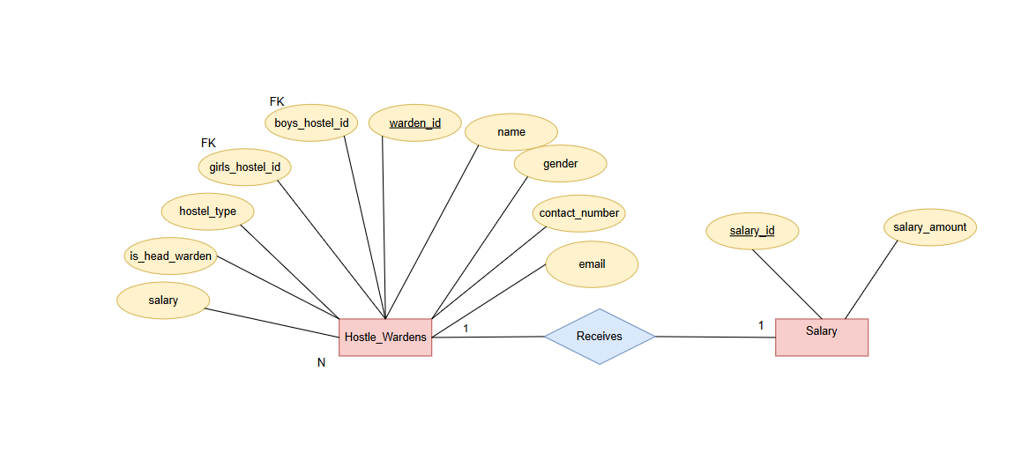
Salary and Hostel Wardens Tables
Each hostel warden is associated with a salary record that defines their compensation details. This ensures proper salary management and payment tracking. Technically, this is a one-to-one relationship where salary_id in the Hostel_Wardens table acts as a foreign key referencing the Salary table.

Slide 27
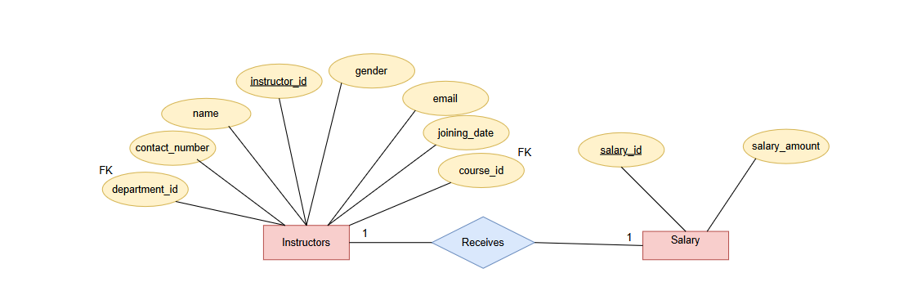
Salary and Instructors Tables
Each instructor is associated with a salary record that defines their compensation details. This ensures proper salary management and payment tracking. Technically, this is a one-to-one relationship where salary_id in the Instructors table acts as a foreign key referencing the Salary table.

Slide 28
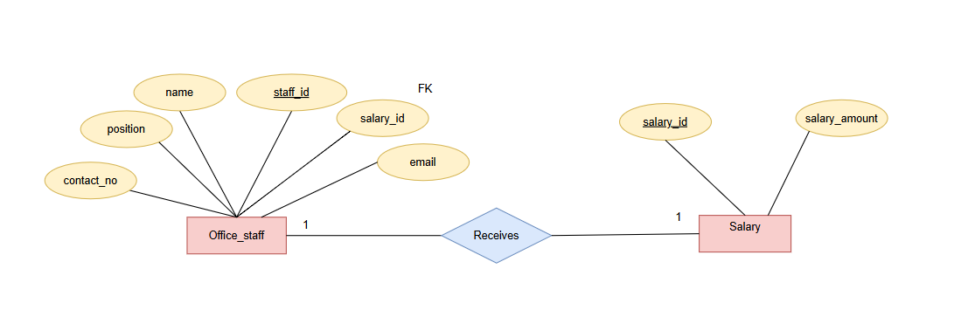
Office Staff and Salary Table
Each office staff member is associated with a salary record that defines their compensation details. This ensures proper salary management and payment tracking. Technically, this is a one-to-one relationship where salary_id in the Office_Staff table acts as a foreign key referencing the Salary table.

Slide 29
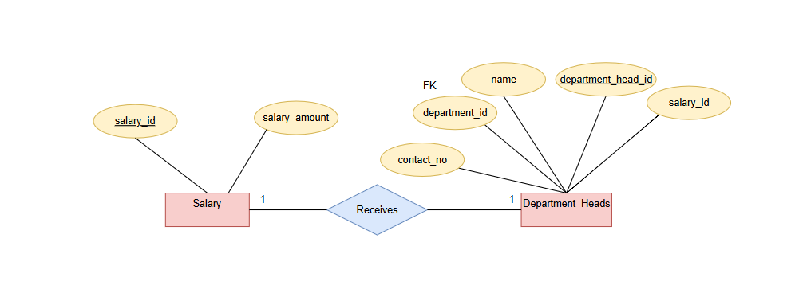
Department Heads and Salary Table
Each department head is associated with a salary record that defines their compensation details. This ensures proper salary management and payment tracking. Technically, this is a one-to-one relationship where salary_id in the Department_Heads table acts as a foreign key referencing the Salary table.

Slide 30
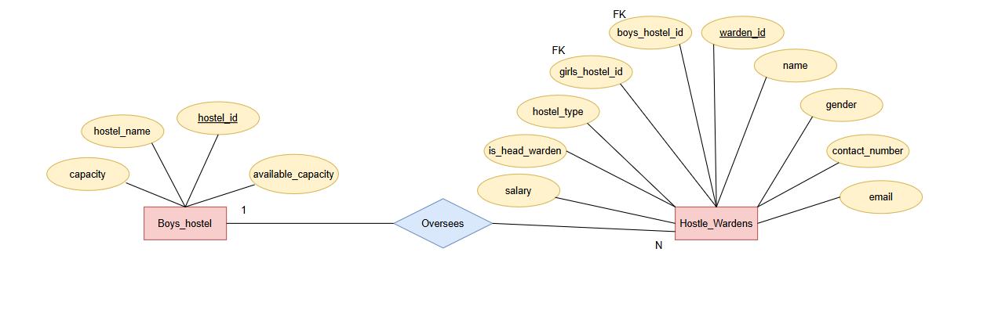
Hostel Wardens and Boys Hostel Tables
Each boys' hostel is managed by a hostel warden responsible for overseeing student accommodations and administrative tasks. This ensures proper hostel management and supervision. Technically, this is a one-to-many relationship where boys_hostel_id in the Hostel_Wardens table acts as a foreign key referencing the Boys_Hostel table.

Slide 31
Boys Hostel and Hostel Allocations
Each boys' hostel accommodates multiple students, with allocations managed through a structured system. This ensures proper room assignment and tracking. Technically, this is a one-to-many relationship where boys_hostel_id in the Hostel_Allocations table acts as a foreign key referencing the Boys_Hostel table.

Slide 32
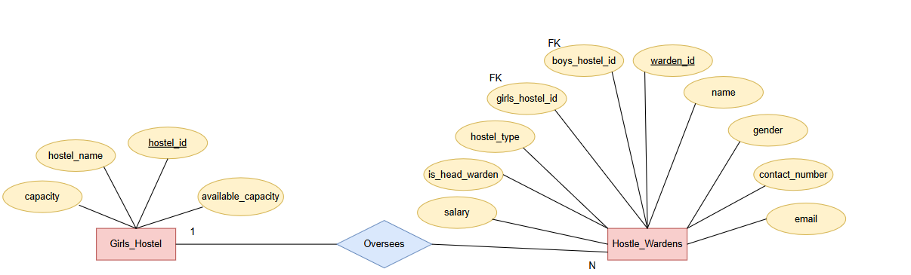
Hostel Warden and Girls Hostel Tables
Each girls' hostel is managed by a hostel warden responsible for overseeing student accommodations and administrative tasks. This ensures proper hostel management and supervision. Technically, this is a one-to-many relationship where girls_hostel_id in the Hostel_Wardens table acts as a foreign key referencing the Girls_Hostel table.

Slide 33
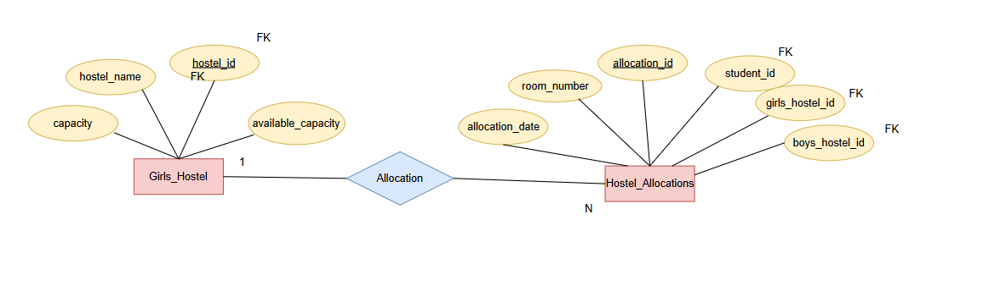
Hostel Allocations and Girls Hostels Table
Each girls' hostel accommodates multiple students, with allocations managed through a structured system. This ensures proper room assignment and tracking. Technically, this is a one-to-many relationship where girls_hostel_id in the Hostel_Allocations table acts as a foreign key referencing the Girls_Hostel table.

Slide 34
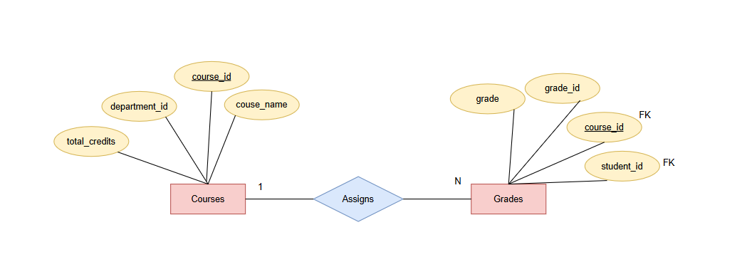
Courses and Grades Tables
Each course is associated with multiple student grades, which record academic performance and credit details. This ensures proper evaluation and tracking of student progress. Technically, this is a one-to-many relationship where course_id in the Grades table acts as a foreign key referencing the Courses table.

Slide 35
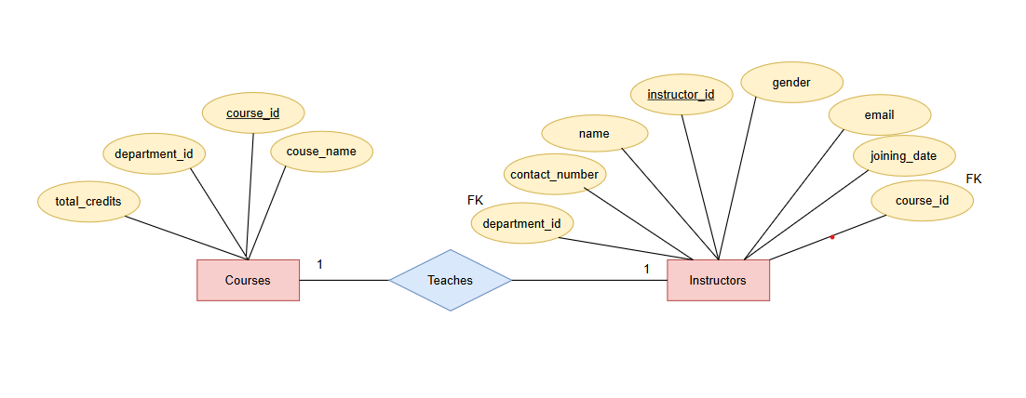
Instructors and Courses Table
Each instructor is assigned to one or more courses, managing lectures, assessments, and academic activities. This ensures efficient course administration and faculty allocation. Technically, this is a one-to-many relationship where course_id in the Instructors table acts as a foreign key referencing the Courses table.

Slide 36
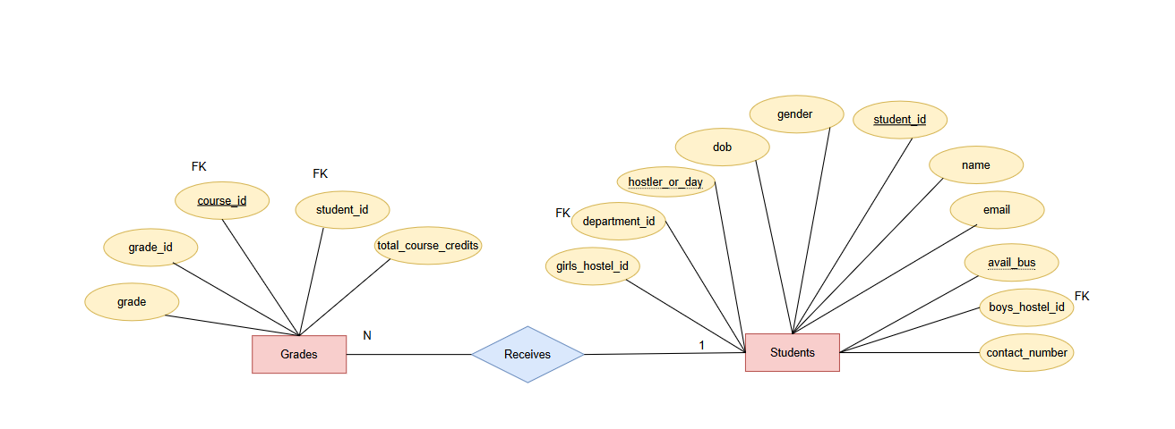
Students and Grades Table
Each student is associated with multiple grades, which record their performance in various courses. This ensures proper evaluation and academic tracking. Technically, this is a one-to-many relationship where student_id in the Grades table acts as a foreign key referencing the Students table.

Slide 37
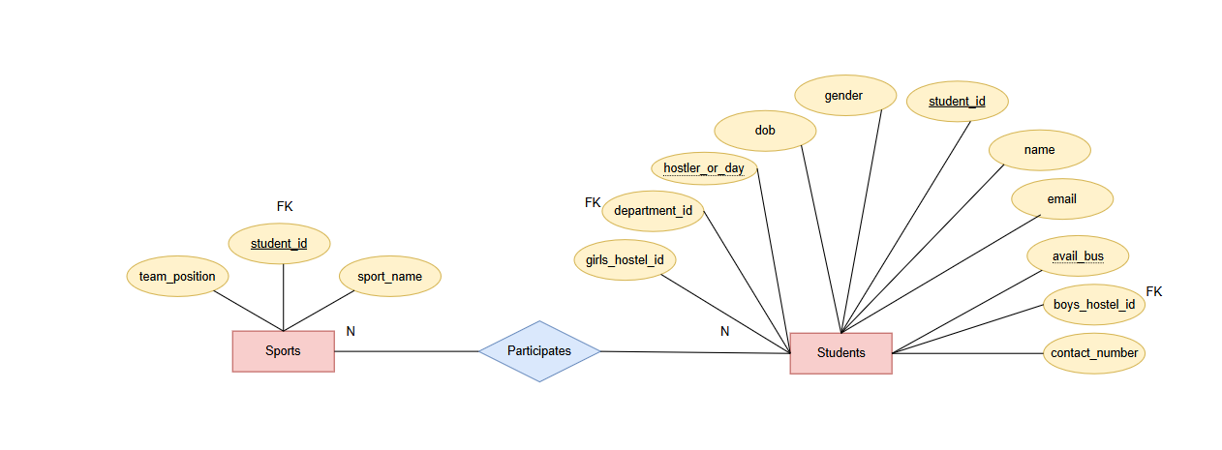
Students and Sports Tables
Each student enrolls in multiple courses as part of their academic curriculum, ensuring structured learning and progress tracking. Technically, this is a many-to-many relationship managed through the Grades table, where student_id and course_id act as foreign keys referencing the Students and Courses tables, respectively.

Slide 38
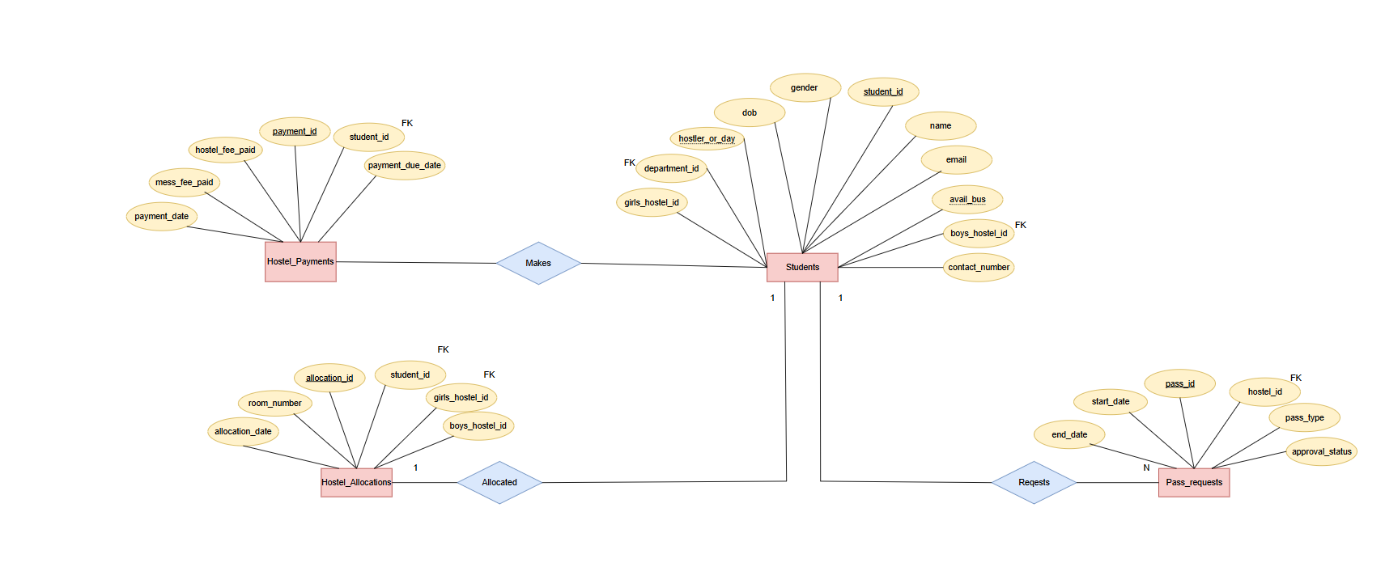
Students, Hostel Payments, Pass Requests and Hostel Allocations Table for Hostel Availing students

Slide 39
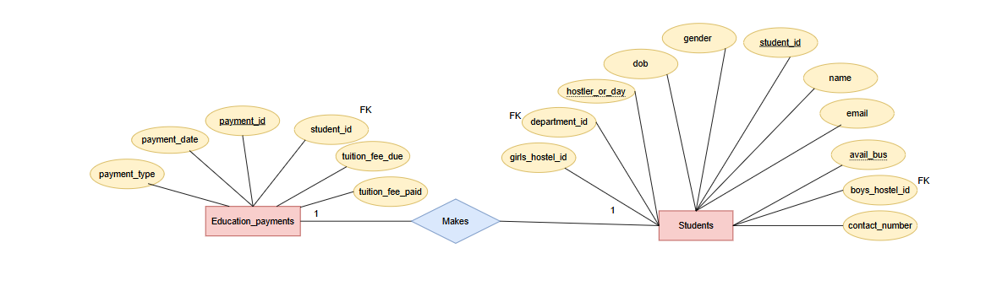
Students and Education Payments Tables
Each student makes multiple education payments for tuition and other academic fees, ensuring proper financial tracking and record-keeping. Technically, this is a one-to-many relationship where student_id in the Education_Payments table acts as a foreign key referencing the Students table.

Slide 40
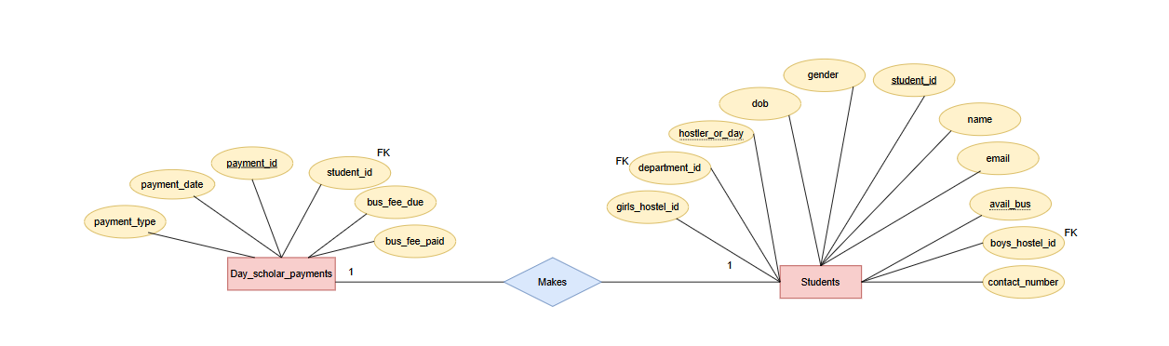
Students and Day Scholar Payments Tables
Each day scholar student makes multiple payments for transportation and related fees, ensuring proper financial tracking and record-keeping. Technically, this is a one-to-many relationship where student_id in the Day_Scholar_Payments table acts as a foreign key referencing the Students table.

Slide 41
Schema Diagram

Slide 42
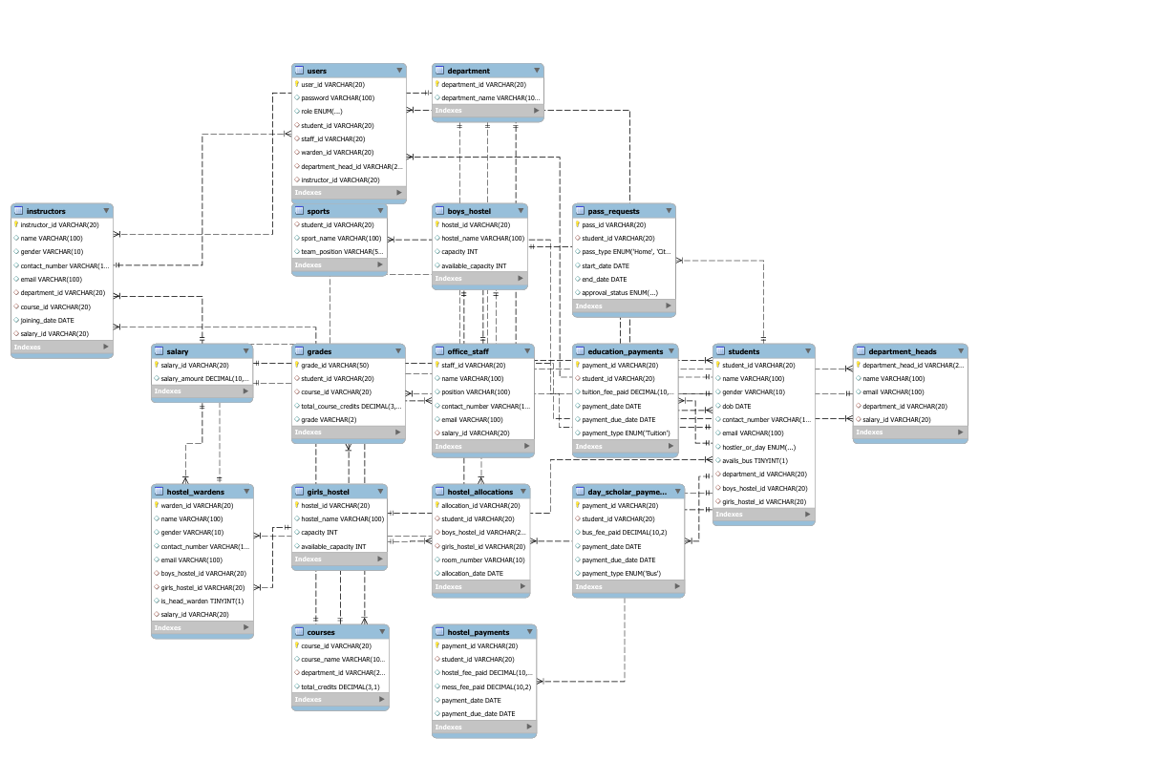

Slide 43
Relationship Between Tables
1.Department and Related Tables
Department ↔ Department_Heads (One-to-One): department_id (FK) in Department_Heads references Department.
Department ↔ Courses (One-to-Many): department_id (FK) in Courses references Department.
Department ↔ Instructors (One-to-Many): department_id (FK) in Instructors references Department.
Department ↔ Students (One-to-Many): department_id (FK) in Students references Department.
2. Users and Related Entities
Users ↔ Students (One-to-One): student_id (FK) in Users references Students.
Users ↔ Instructors (One-to-One): instructor_id (FK) in Users references Instructors.
Users ↔ Department_Heads (One-to-One): department_head_id (FK) in Users references Department_Heads.
Users ↔ Hostel_Wardens (One-to-One): warden_id (FK) in Users references Hostel_Wardens.
Users ↔ Office_Staff (One-to-One): staff_id (FK) in Users references Office_Staff.

Slide 44
Relationship Between Tables
3. Hostel Management
Boys_Hostel ↔ Hostel_Wardens (One-to-Many): boys_hostel_id (FK) in Hostel_Wardens references Boys_Hostel.
Girls_Hostel ↔ Hostel_Wardens (One-to-Many): girls_hostel_id (FK) in Hostel_Wardens references Girls_Hostel.
Boys_Hostel ↔ Hostel_Allocations (One-to-Many): boys_hostel_id (FK) in Hostel_Allocations references Boys_Hostel.
Girls_Hostel ↔ Hostel_Allocations (One-to-Many): girls_hostel_id (FK) in Hostel_Allocations references Girls_Hostel.
Students ↔ Hostel_Allocations (One-to-One): student_id (FK) in Hostel_Allocations references Students.
4. Course and Academic Management
Courses ↔ Instructors (One-to-Many): course_id (FK) in Instructors references Courses.
Courses ↔ Grades (One-to-Many): course_id (FK) in Grades references Courses.
Students ↔ Grades (One-to-Many): student_id (FK) in Grades references Students.
Students ↔ Courses (Many-to-Many): Managed through Grades, where student_id and course_id act as FKs.

Slide 45
Relationship Between Tables
5. Payment and Financial Records
Students ↔ Education_Payments (One-to-Many): student_id (FK) in Education_Payments references Students.
Students ↔ Day_Scholar_Payments (One-to-Many): student_id (FK) in Day_Scholar_Payments references Students.
Students ↔ Hostel_Payments (One-to-Many): student_id (FK) in Hostel_Payments references Students.
6. Salary Management
Salary ↔ Instructors (One-to-One): salary_id (FK) in Instructors references Salary.
Salary ↔ Office_Staff (One-to-One): salary_id (FK) in Office_Staff references Salary.
Salary ↔ Department_Heads (One-to-One): salary_id (FK) in Department_Heads references Salary.
Salary ↔ Hostel_Wardens (One-to-One): salary_id (FK) in Hostel_Wardens references Salary.

Slide 46
IMPLEMENTATION
Backend Development with PHP – Developed server-side logic for form validation, CRUD operations, and session management.
Database Integration with MySQL – Designed the schema, implemented relationships, and ensured efficient data handling.
Frontend Development with HTML & CSS – Created a responsive user interface for seamless interaction.
Server Setup & Integration – Configured XAMPP, linked frontend with backend, and enabled smooth data exchange.
Testing & Deployment – Conducted testing, fixed issues, optimized performance, and deployed the system.

Slide 47
User Interfacee Design

Slide 48
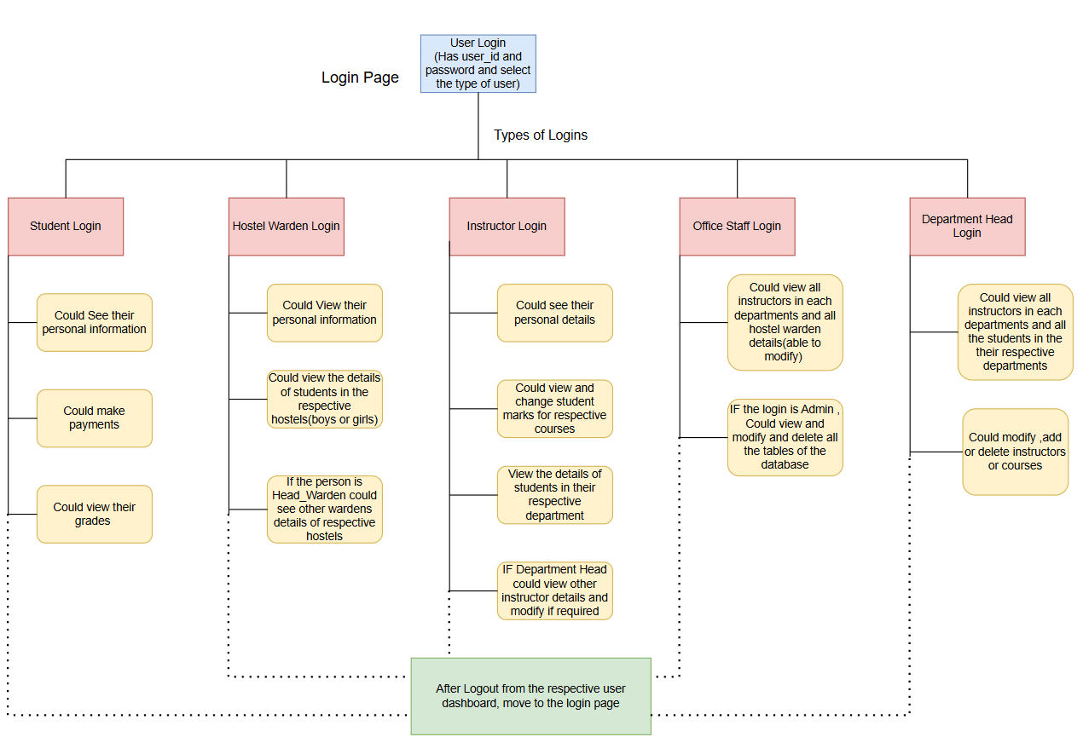
UI Design Flowchart

Slide 49
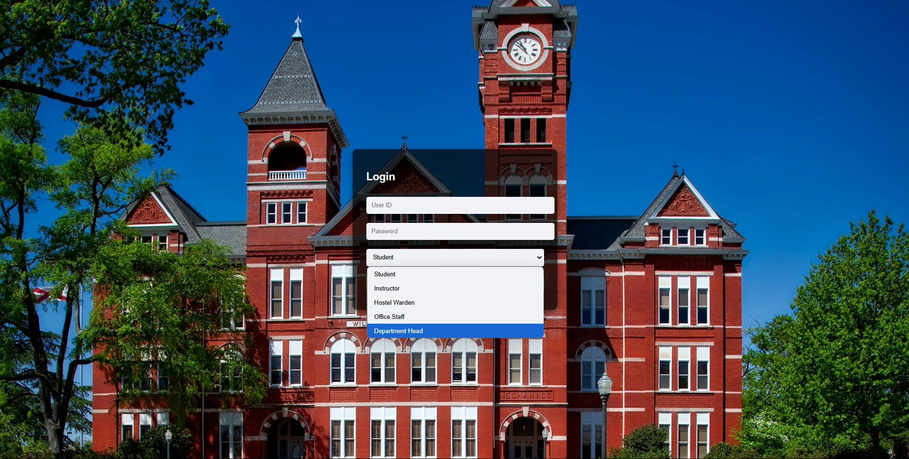
Login Page

Slide 50
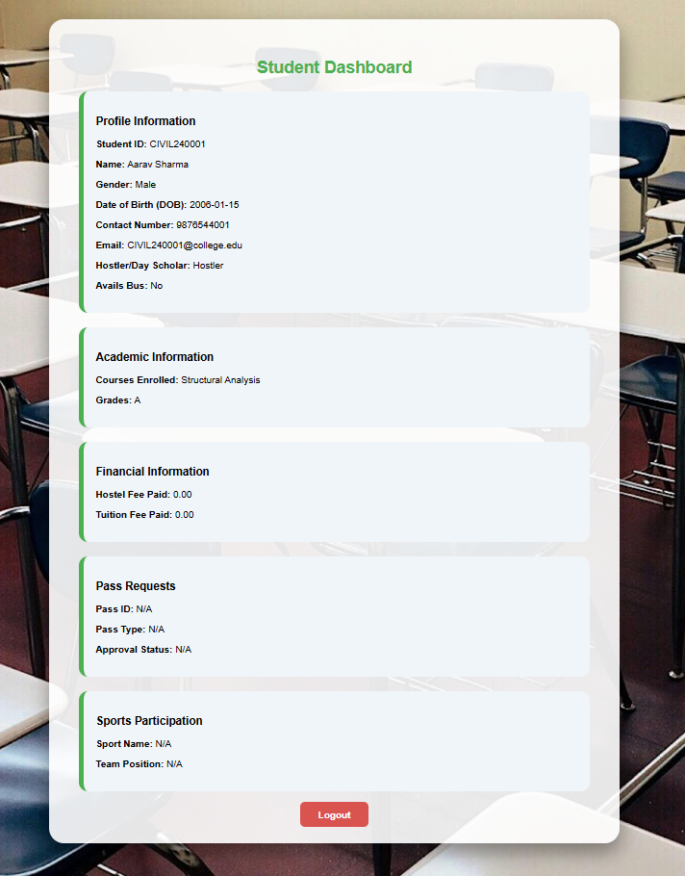
Student
Login Dashboard

Slide 51
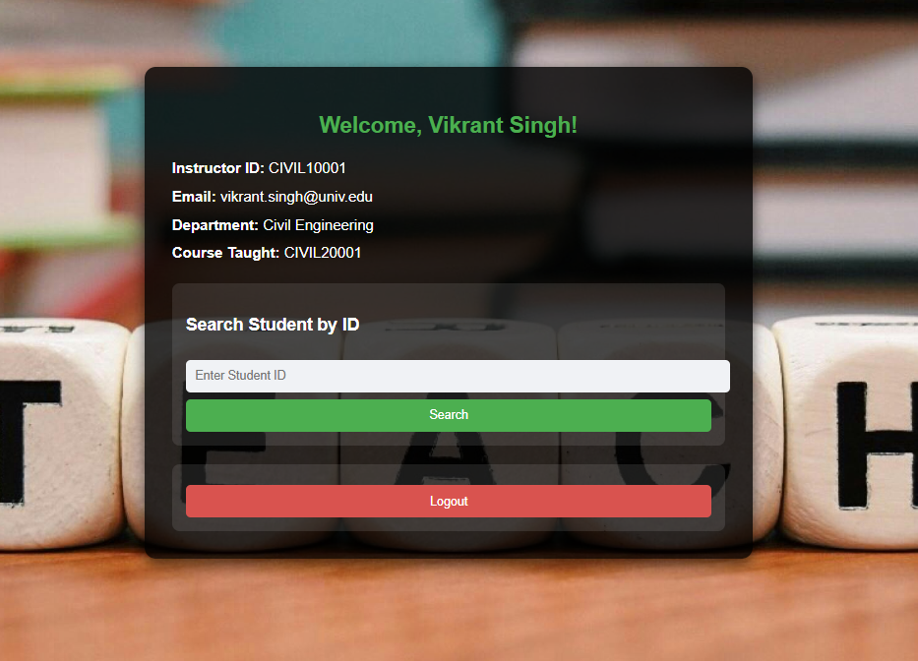
Instructor Login page

Slide 52
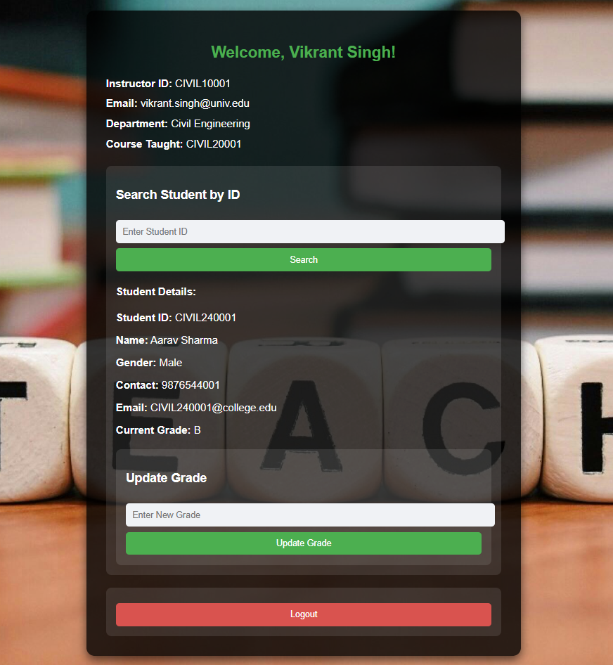
Instructor dashboard
With Student details

Slide 53
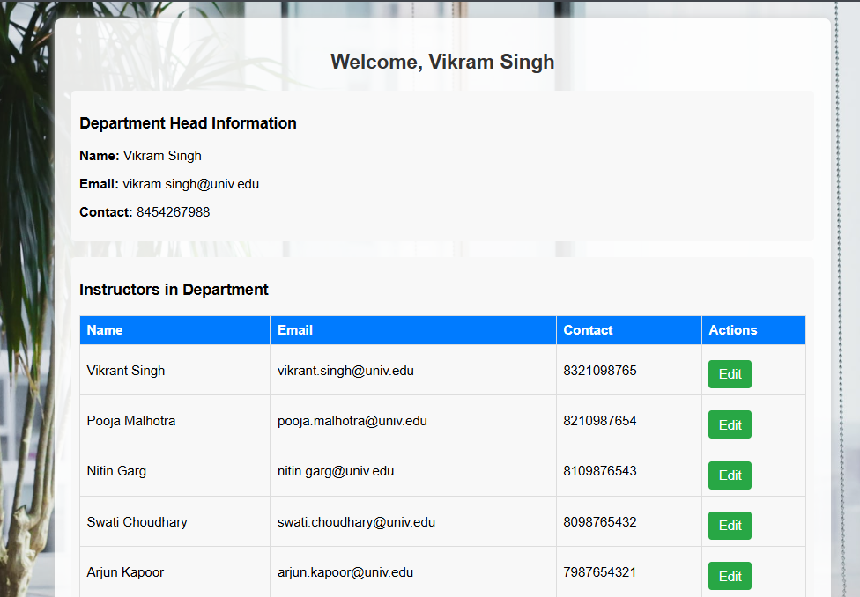
Department Head Login dashboard

Slide 54
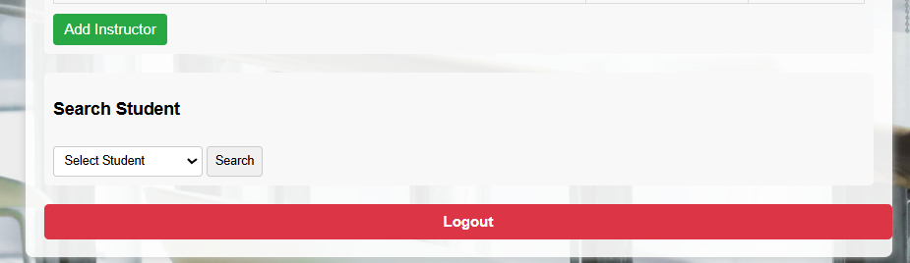

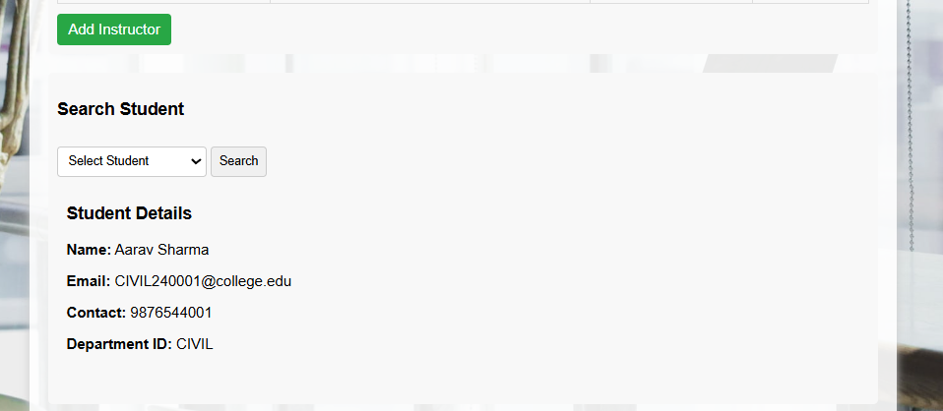
Department Head Interface with student of each department .

Slide 55
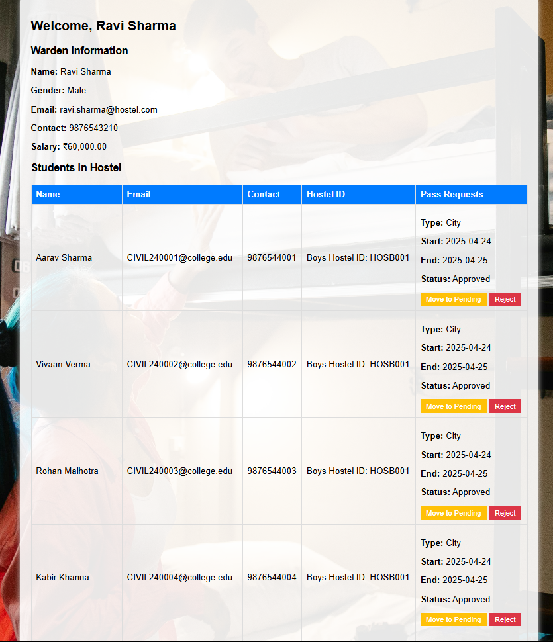
Hostel warden Login
Dashboard

Slide 56
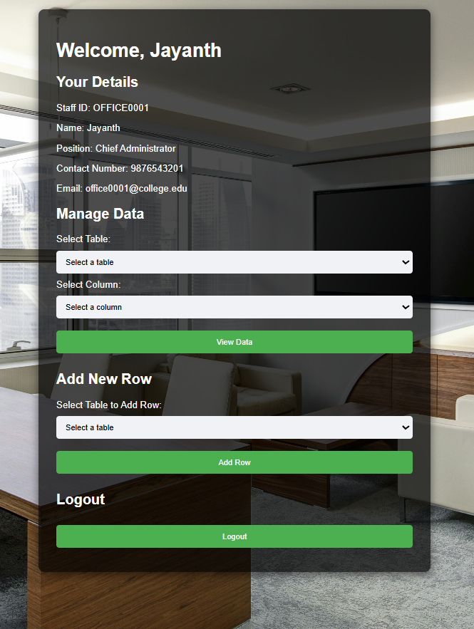
Office Staff Login
Dashboard

Slide 57
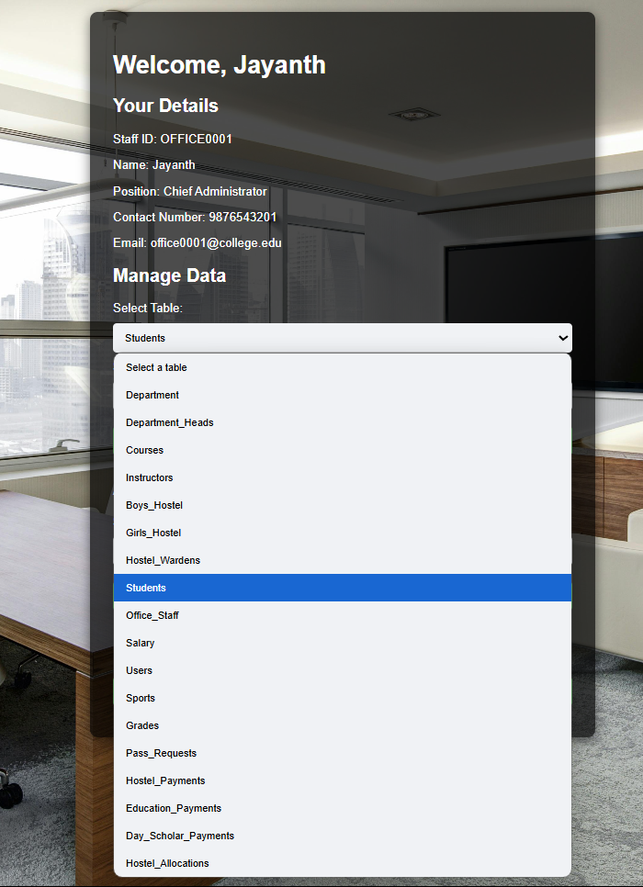
Office Staff Login
Dashboard – Details of the
Database

Slide 58
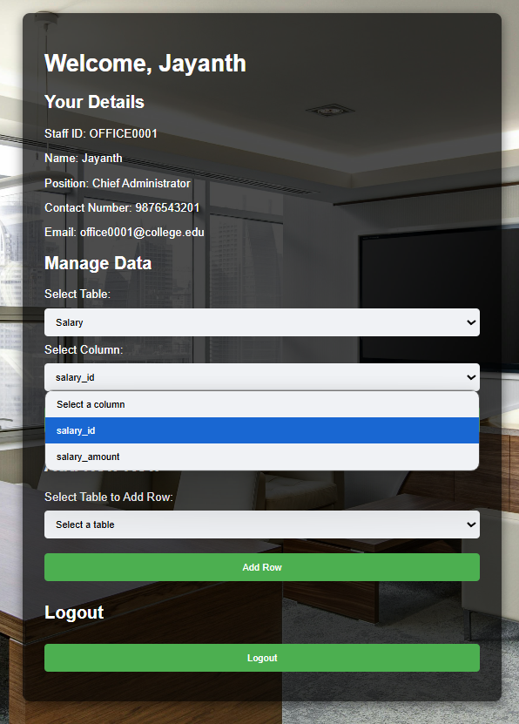
Office Staff Login Dashboard – Managing
Data

Slide 59
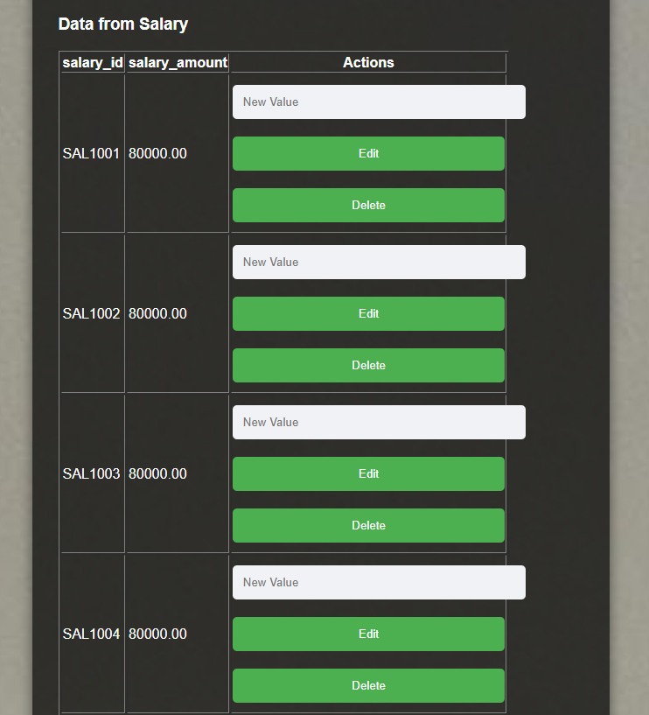
Office Staff UI

Slide 60
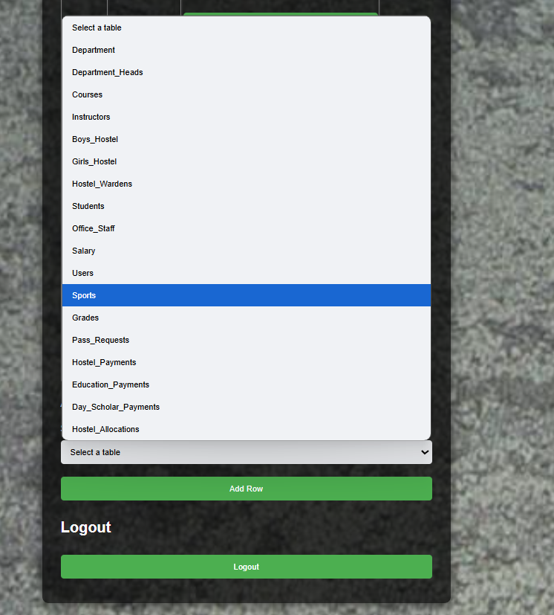
Office Staff UI

Slide 61
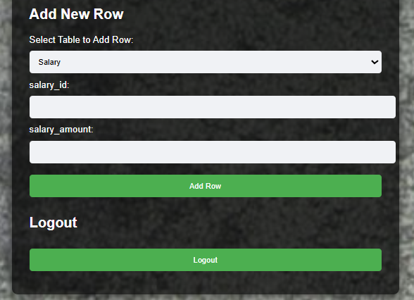
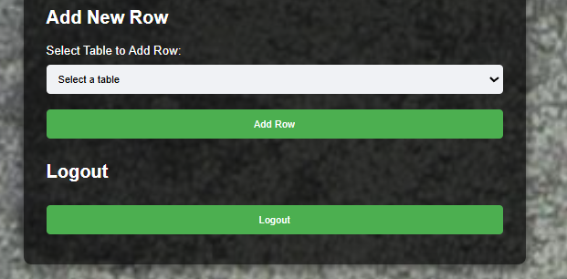

Office Staff UI

Slide 62
Challenges Faced
Database Connectivity – Ensuring smooth interaction between PHP and MySQL.
Role-Based Access Control – Managing permissions for different user roles securely.
Query Optimization – Improving database performance for fast data retrieval.
Secure Authentication & Validation – Preventing unauthorized access and ensuring data integrity.
User Interface Design – Balancing functionality with a user-friendly experience.
Debugging & Dependency Management – Resolving PHP errors and handling XAMPP server configurations.

Slide 63
Future Enhancements
Integration of JavaScript & AJAX – Improve user experience with real-time data updates and dynamic content.
Automated Notifications – Implement email/SMS alerts for important updates like payments and interview schedules.
Advanced Analytics & Reports – Generate detailed insights on student performance, placements, and fee records.
Mobile-Friendly Interface – Enhance responsiveness for seamless access on mobile devices.
AI-Based Recommendations – Use AI to suggest courses, career paths, and placement opportunities.
Cloud Deployment – Migrate to a cloud-based system for better scalability and accessibility.
Online Payment Integration – Enable secure digital payments for tuition, hostel, and transport fees.
Automated Notifications – Implement email/SMS alerts for fee reminders, exam schedules, and important updates.
Mobile App Development – Create a mobile-friendly version for easy access to student records and services.

Slide 64
Conclusion
The Student Database Management System successfully streamlines student records, course management, hostel allocations, and payment processing through a centralized, efficient, and secure platform. By integrating PHP, MySQL, HTML, and CSS, the system enhances data management, accessibility, and transparency for students, faculty, and administrators. Future enhancements like online payments, automated notifications, and mobile accessibility will further improve efficiency, making the system more robust and user-friendly.

Slide 65
Thank you

